Slide 1
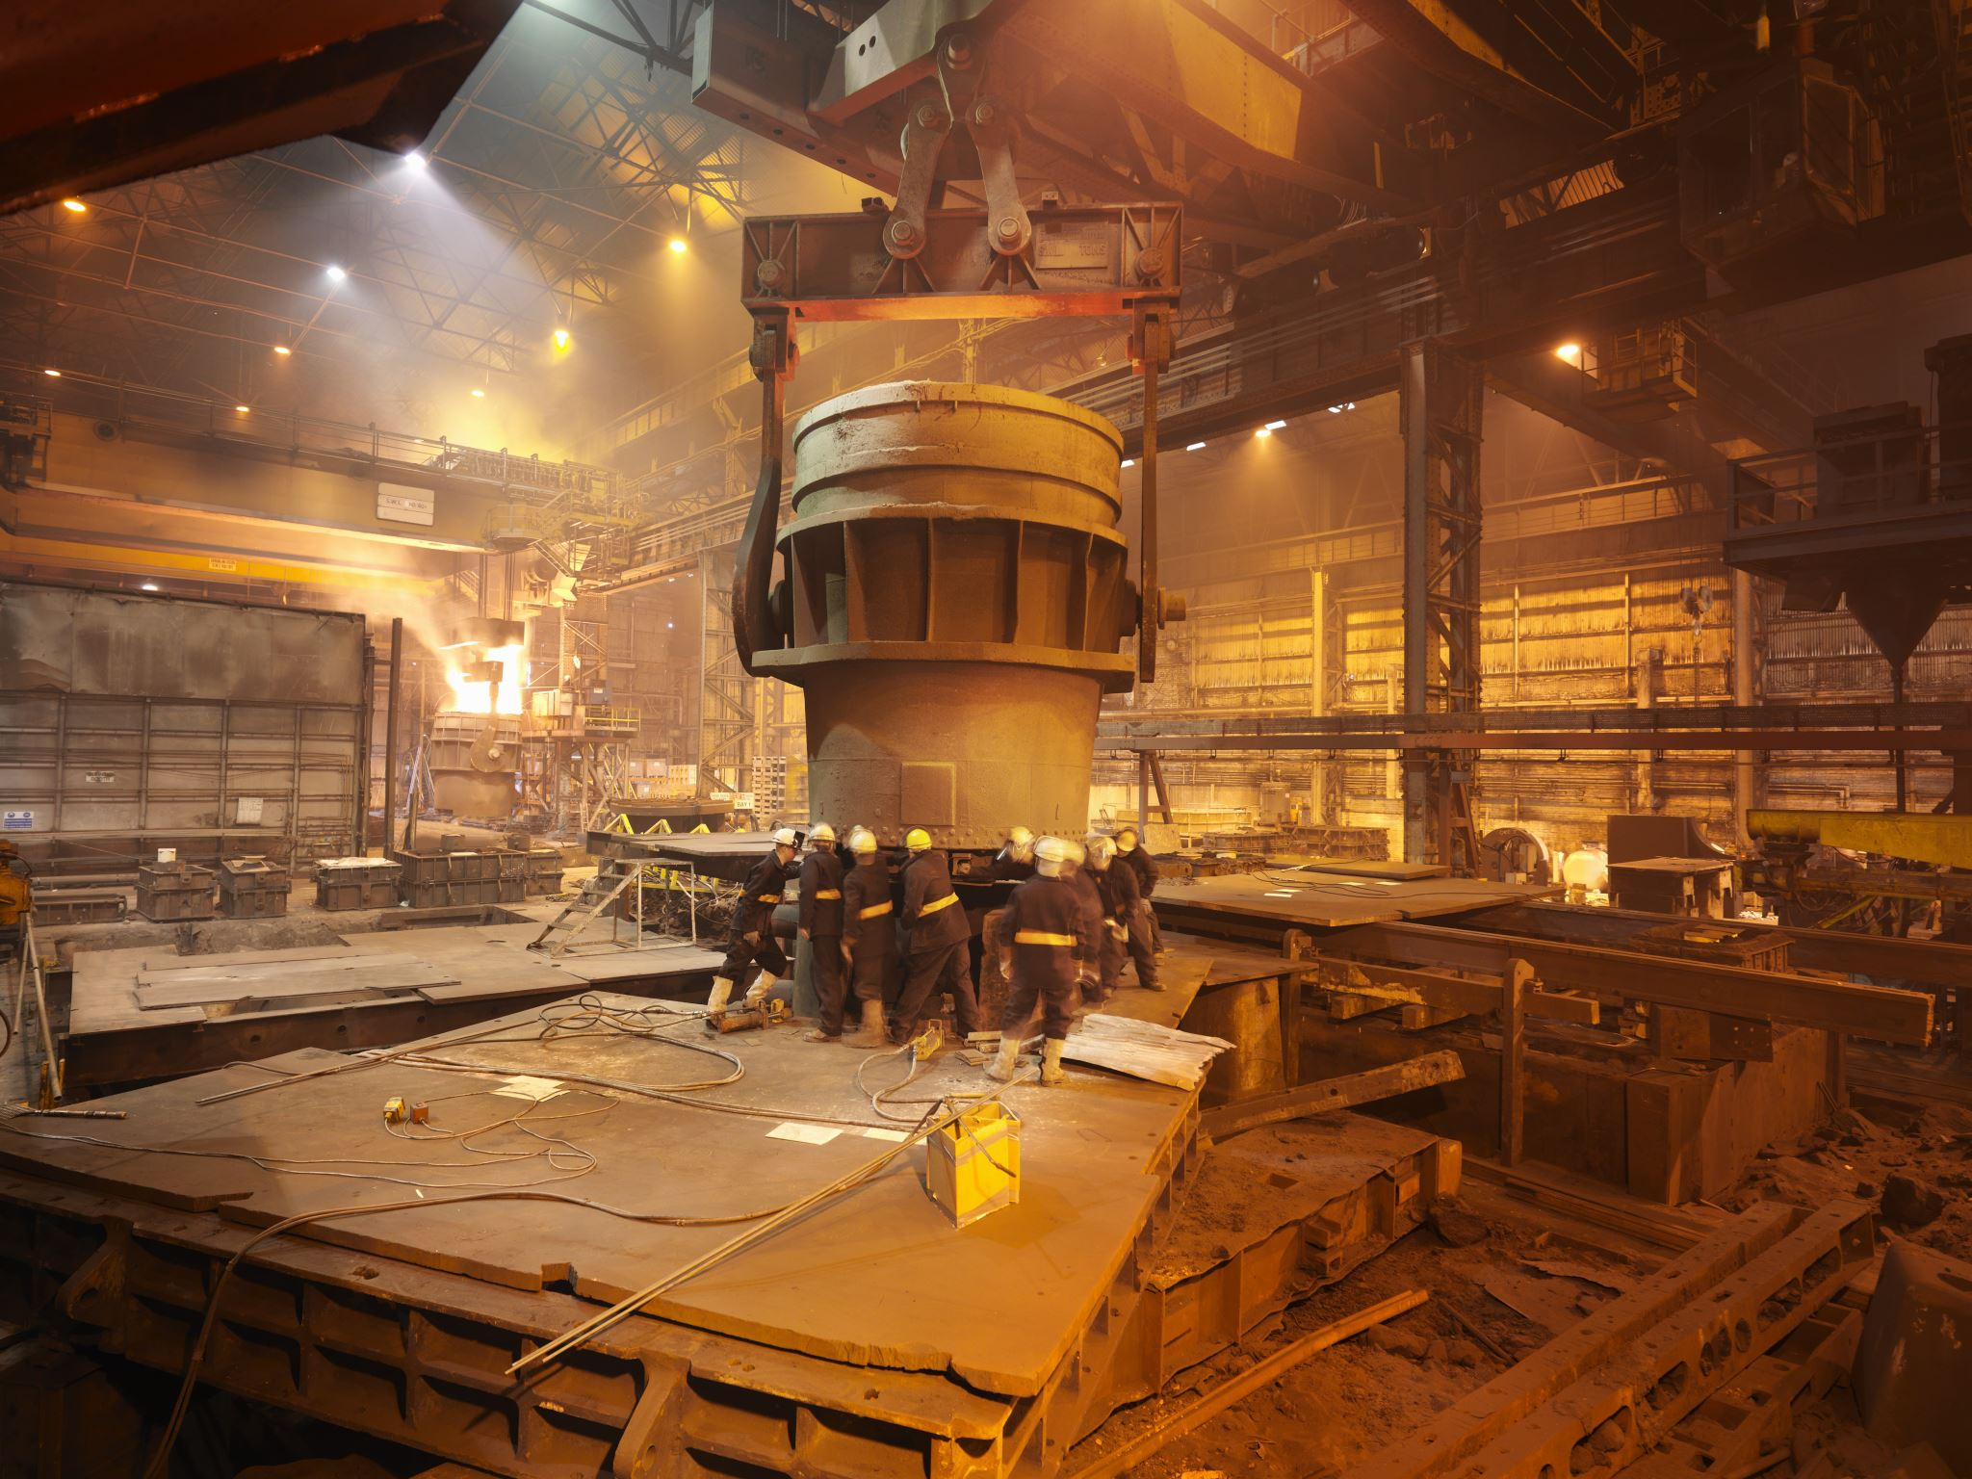

O3 levels in Europe Visualization
5011CEM Big Data programming project

Slide 2
O3 levels in Europe
Data file
.nc file contains a 4D matrix format:
8 models
24 hours
Longitude
Latitude

Slide 3
Visualization of O3 levels in Europe
Essential for visual analysis
Compares model’s differences
Essential for making a better decision
Verify existence of errors when collecting the data
Helps communicating the data to others
Understanding of the overall data.

Slide 4
Visualization Project
Techniques
Upload and open file
xarray
Data extraction
numpy
Graphical visualization
matplotlit
Parallel processing
Concurrent.futures

Slide 5
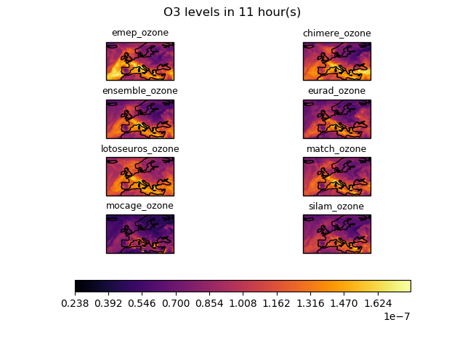
Visualization Project
Inputs:
Terminal input text to give the user the option of choosing:
Colour sets
Display of graphs
Outputs:
24 images, one per hour
8 graphs per image representing the data of each model

Slide 6
Methods

Slide 7
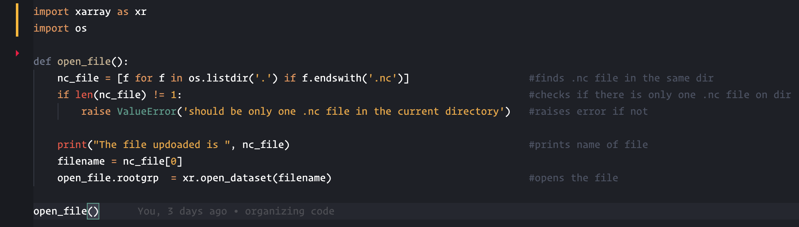
Open_file()
Fetchs the file with .nc extention
Xarray opens it

Slide 8
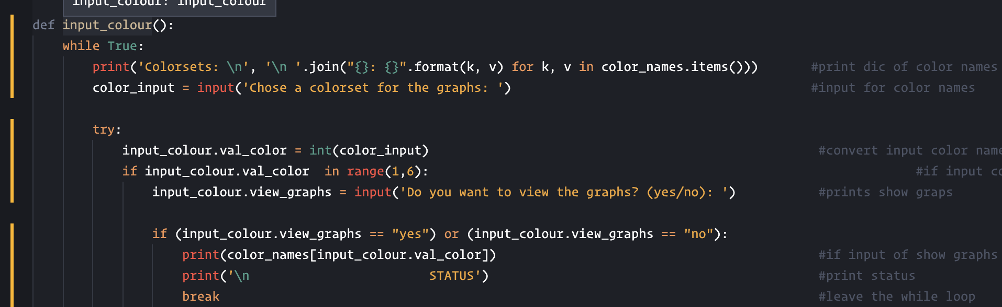
Input_colour()
Asks the user for a colour set
Asks the user if graph display is desired

Slide 9
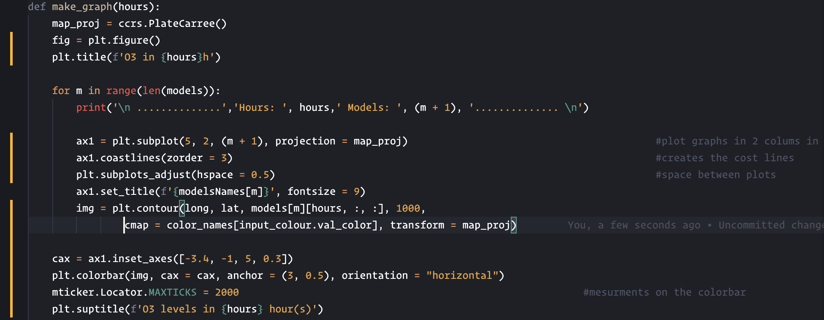
Make_graph()
Creates the windows
Creates the map
Creates the axis
Plots the data
Creates the colorbar

Slide 10
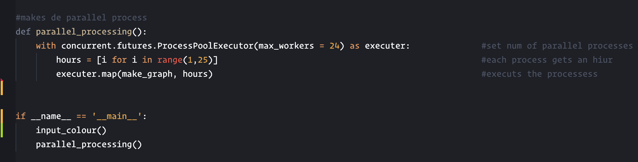
parallel_processing()
Sets the number of processes to be run at the same time
Loops through all the hours
Passes the hours to function make_graph()

Slide 11
Future
Notes:
Colour blindness research to implement more suitable colour pallets
Better image quality when saving images -- less pixelated
Better implementation of code of more efficient execution
Implementation of TDD
More test coverage of code
Overall all specification were achieved

Slide 12
In what way would you need to adapt your code if we had to process 10 years of data?
Notes:
(<1 min)
Data display will not be possible as it takes a long time (only saving on directory)
matlab would probably be a better choise since matplotlib takes a very long time to generate the graphs
Have the option to chose only one hour to visualize instead of always ploting all graphs

Slide 13
State 3 ways in which you adapted either your project outline, specification and flow chart (or other code planning method) as your project progressed. If you made no changes, please say so.
Notes:
(<2 min)
The initial plan was to plot all the hours for each model in a window, but changed days later bc the purpose of the visualization was to have a visual comparison of each model. This did not satisfy that requirement, as so a better approach was outlined.
Initially the software was not meant to store the images in a directory but due to the long waiting time for the matplotlib to process the graphs, saving them instead of showing them as a better option
Parallel processing was initially meant to to use threads instead of processes

Slide 14
Our next project will analyse atmospheric CO2 over Europe. If the data is provided in the same format describe how easy will it be to adapt your code to work with this new data?
Notes:
(<1 min)

